Slide 1
Multidimensional Datasets

Slide 2
Universal Imaging and Spectroscopic Data (USID)
Data stored as 2D matrix of (position x spectral values) regardless of dimensionality
Ancillary datasets explain the data
Example data types:
2D images = (N_{pixels} x 1)
Single spectra = (1 x Z_{steps})
Spectroscopy on grid = (N_{pixels}x V_{steps})
Position Values
Position Indices
Measurement / Analysis parameters→
Attribute A
…
Attribute Z
Time / Spectral →
←Location
2D Matrix for an Entire Spectral-Image Chunked by outermost position loop.
These results have been already normalized by the excitation band
Main Dataset
Spectroscopic Indices
Spectroscopic Values

Slide 3
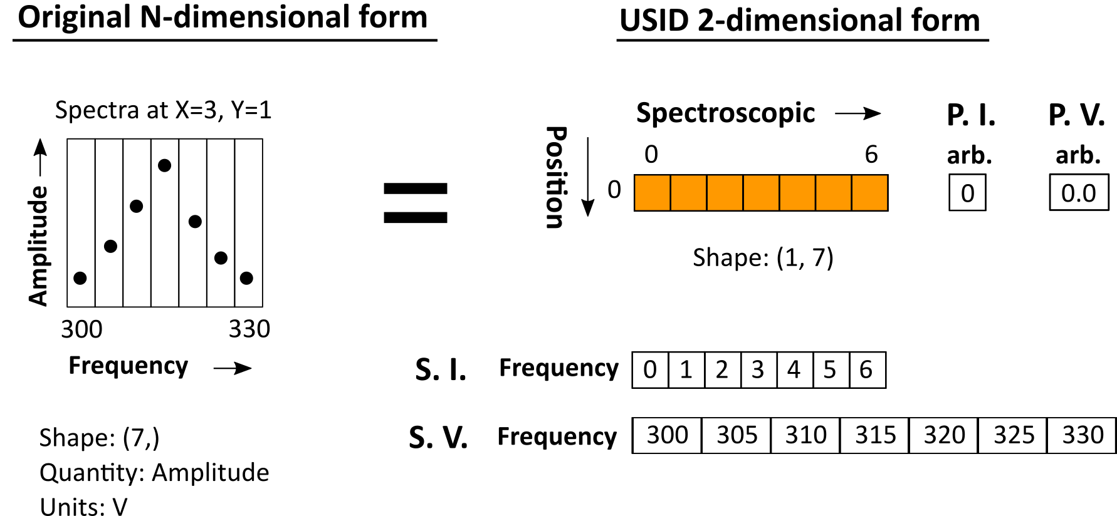
USID – 1D spectra

Slide 4
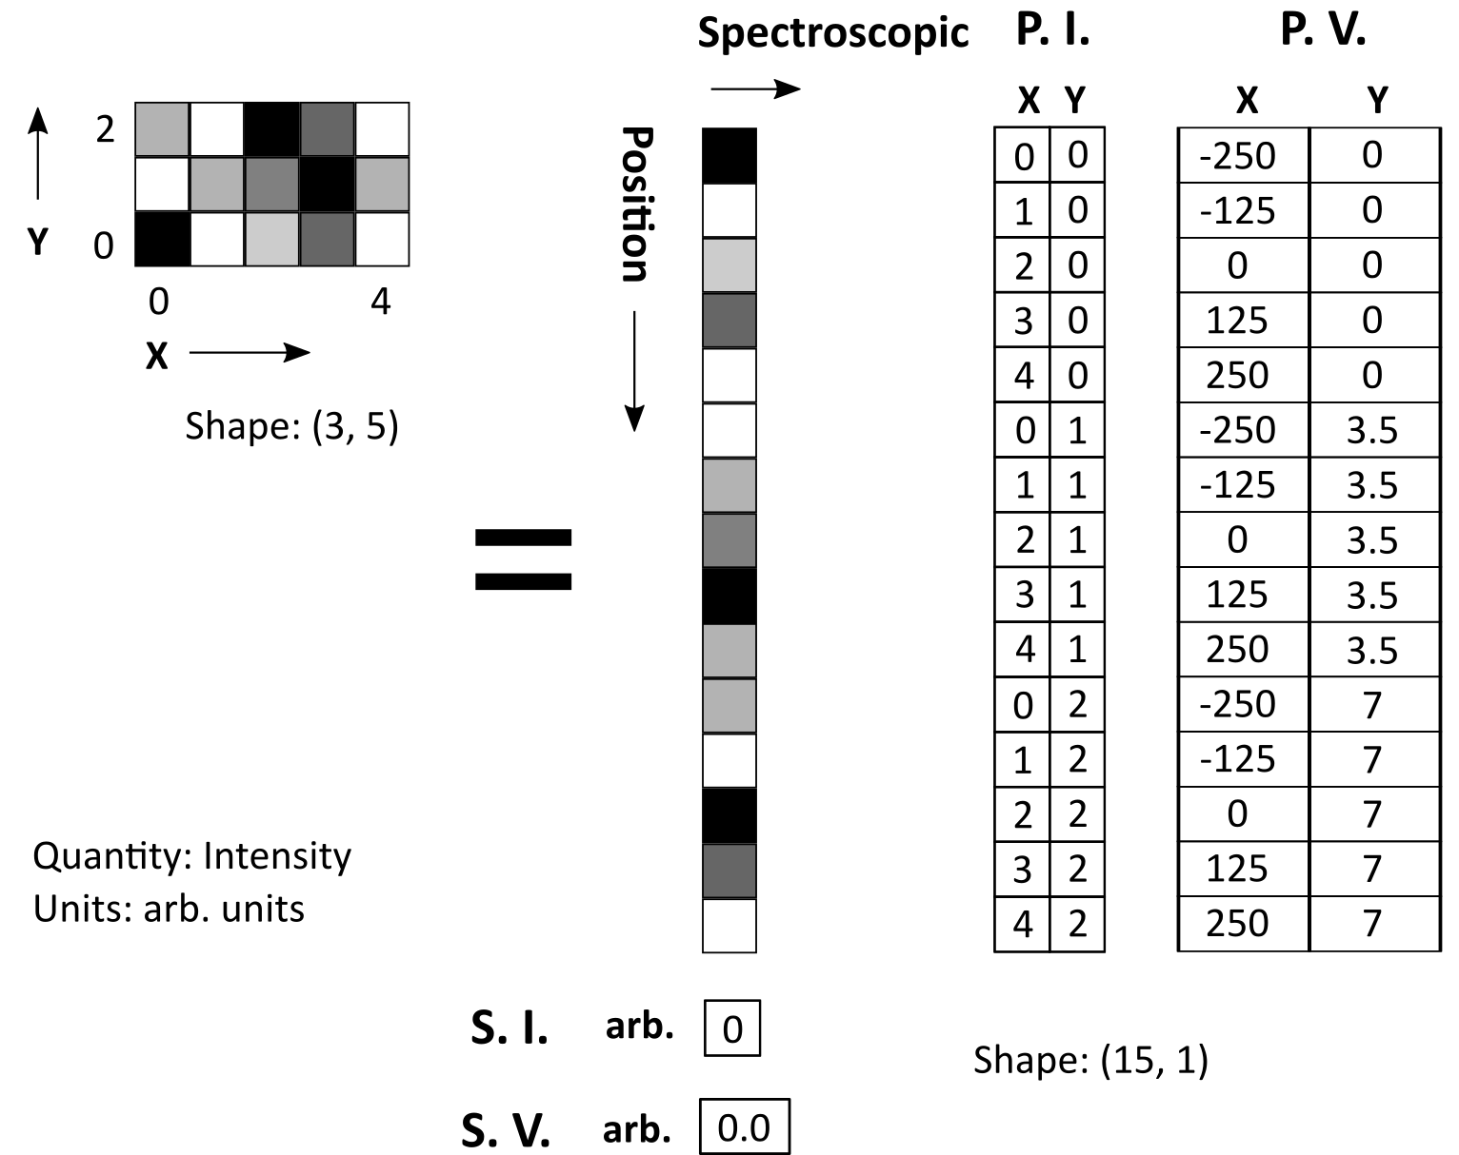
USID – 2D Image
USID 2D form
Original N-D form

Slide 5
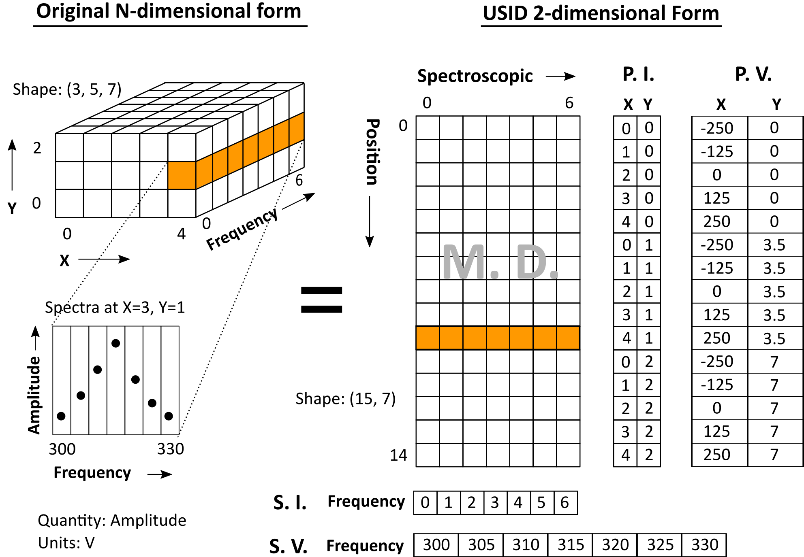
USID – Spectra on Grid (3D)

Slide 6
USID - Instrument Agnostic Code
Instrument-agnostic data allows instrument-agnostic code
Single version of analysis and processing routine
Brings multiple scientific communities together
SPM
Multispectral imaging
FFT filtering
Functional fitting
STM I-V spectroscopy
Decomposition
STEM
ptychography
Clustering

